Slide 1
Model View Controller

Slide 2
MVC Reasoning
Any application has 2 primary parts:
Data being manipulated
A UI through which to perform the manipulation
Data is logically independent from its presentation
Display may also change over time, should be flexible

Slide 3
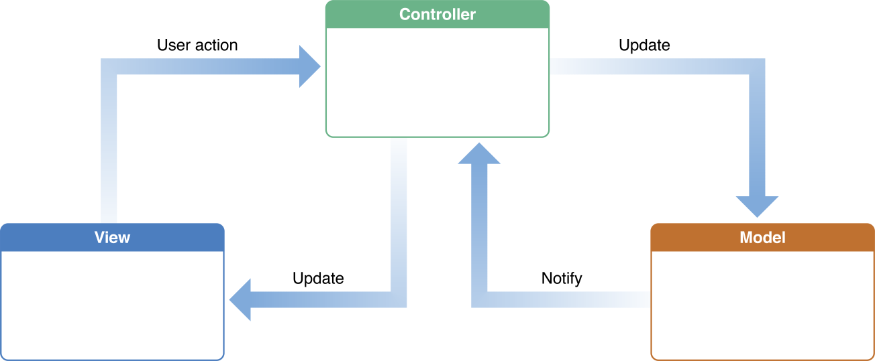
MCV – Basic Principle and Communication Patterns
https://developer.apple.com/library/ios/documentation/General/Conceptual/DevPedia-CocoaCore/MVC.html
Notes:
MVC allows user interactions and code outside the project to be easily abstracted away.
https://developer.apple.com/library/mac/documentation/General/Conceptual/DevPedia-CocoaCore/ControllerObject.html

Slide 4
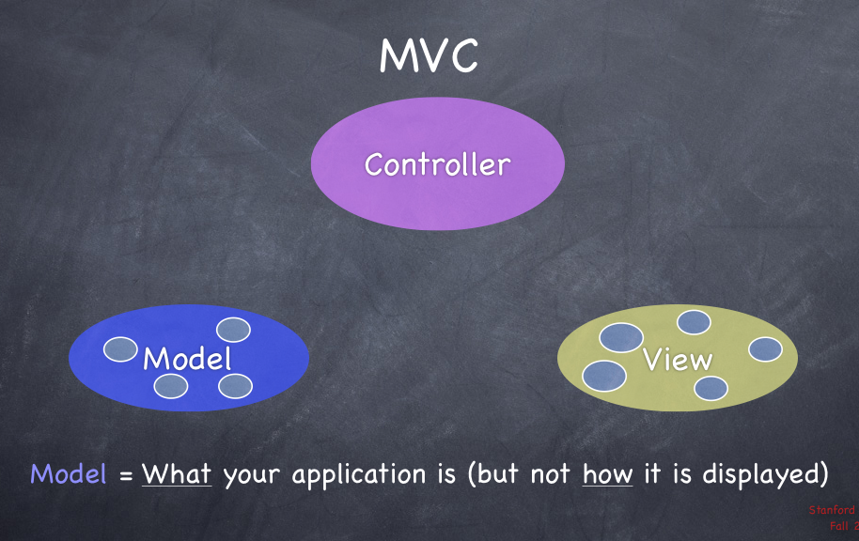
https://github.com/sebastienwindal/iOSPatterns/wiki/standard-iOS-patterns

Slide 5


Slide 6
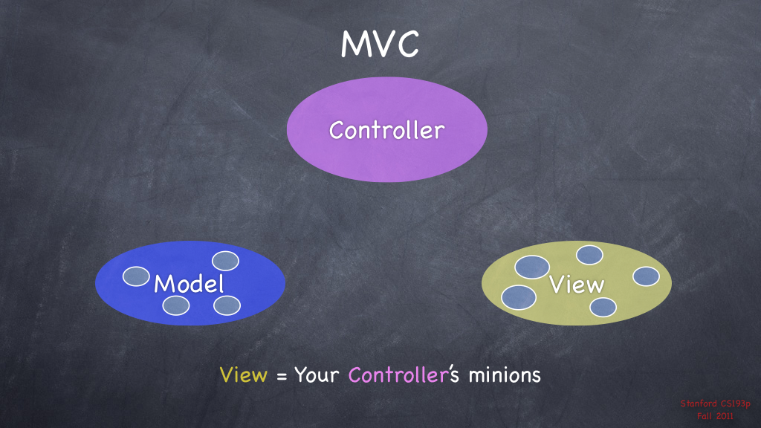

Slide 7
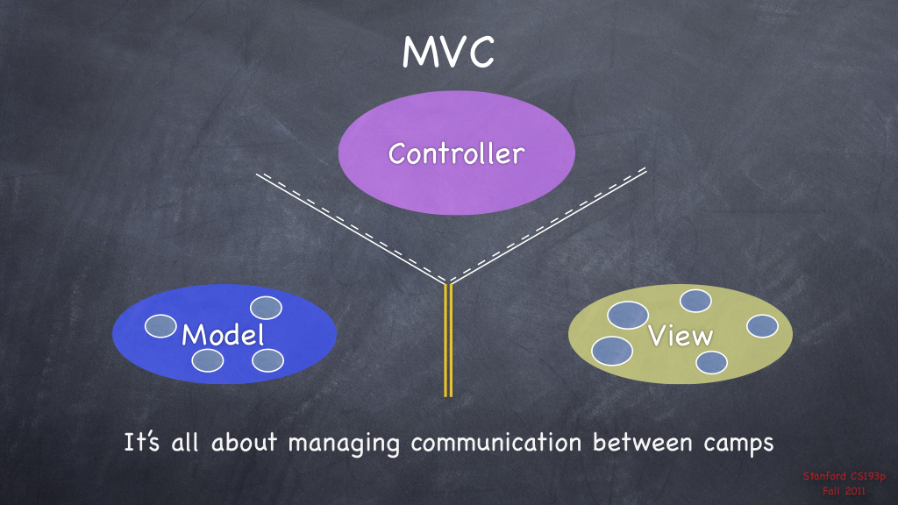
Notes:
View is a subclass of UIView
Controller is a subclass of UIViewController
Model is typically a subclass of NSObject, though it does not need to be
Model may need to speak with view in performance heavy applications but it is typically not recommended.
Controller and view will typically share SOME state data (is a field active, is a field filled in but not returned yet, etc…) , but this can be dangerous and should be regulated

Slide 8
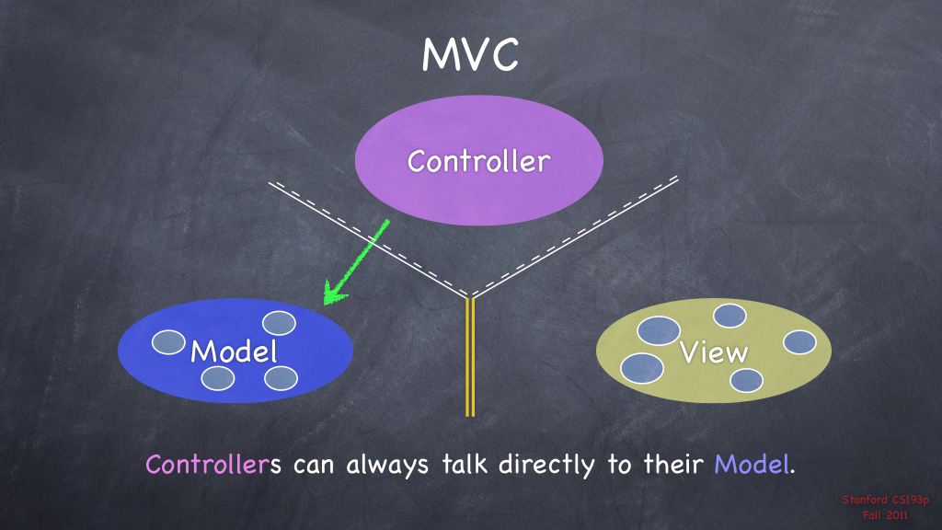

Slide 9


Slide 10
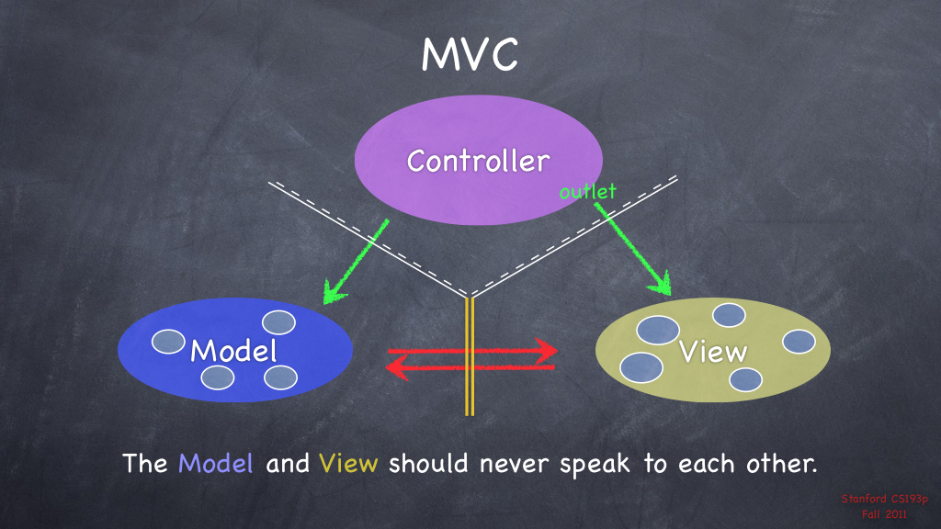
Notes:
Can the model be used with a completely different UI and still be functional? If not then there is some intrinsic coupling

Slide 11
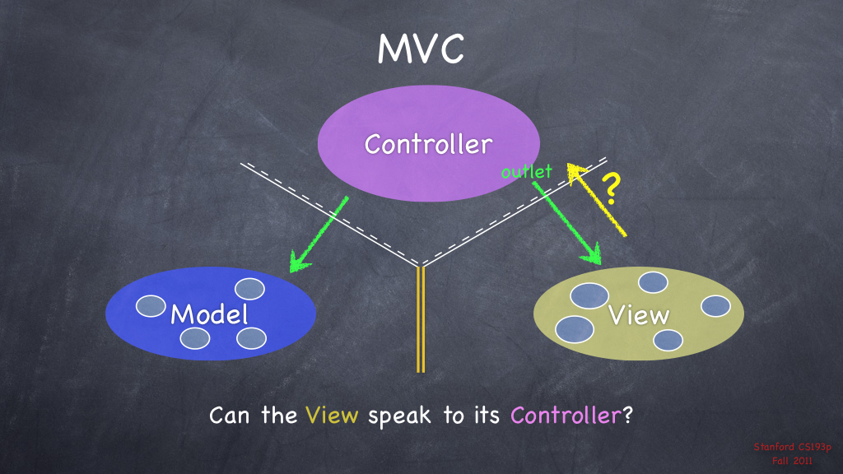

Slide 12


Slide 13
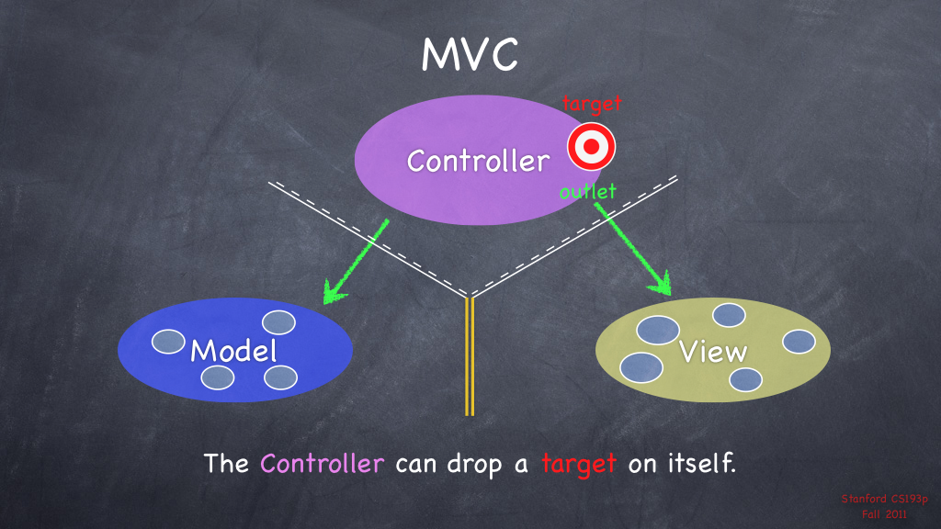

Slide 14
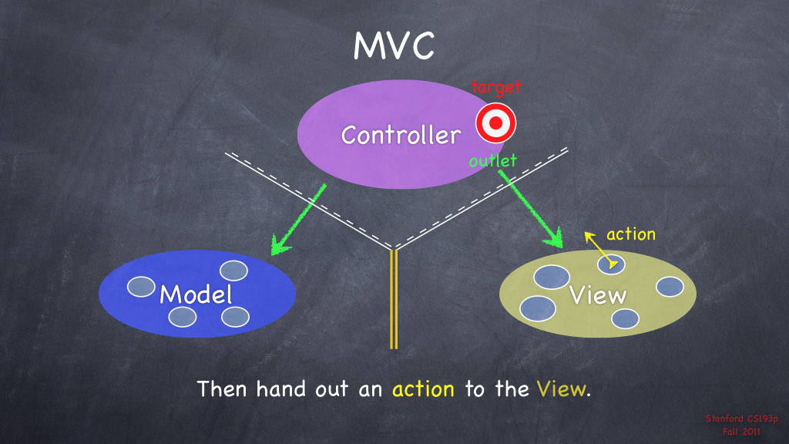

Slide 15
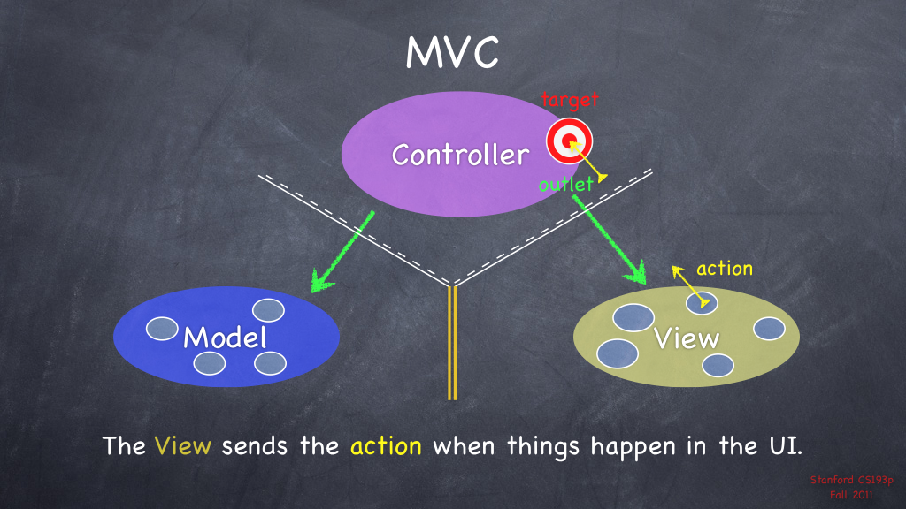

Slide 16
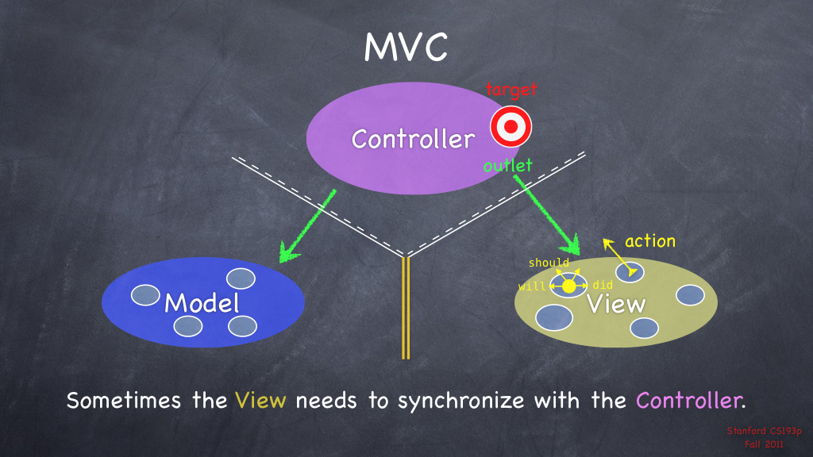

Slide 17
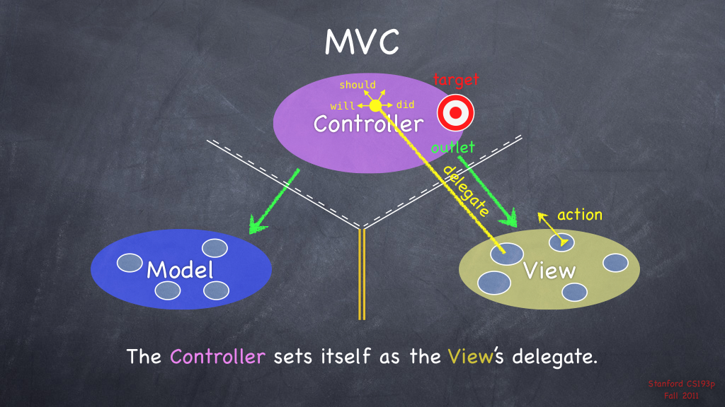

Slide 18
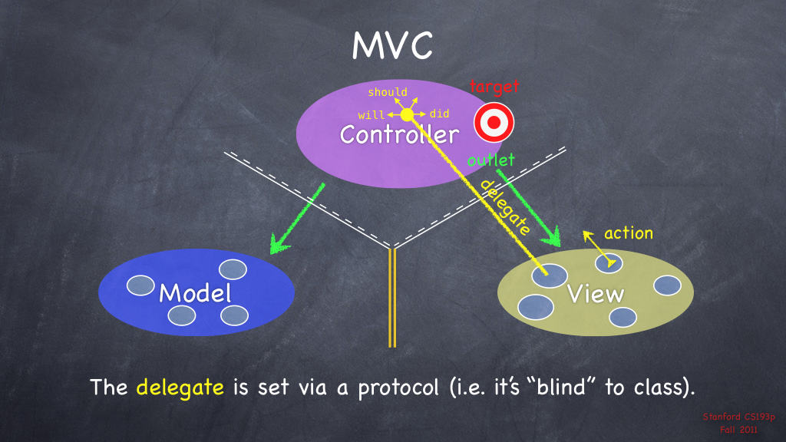

Slide 19
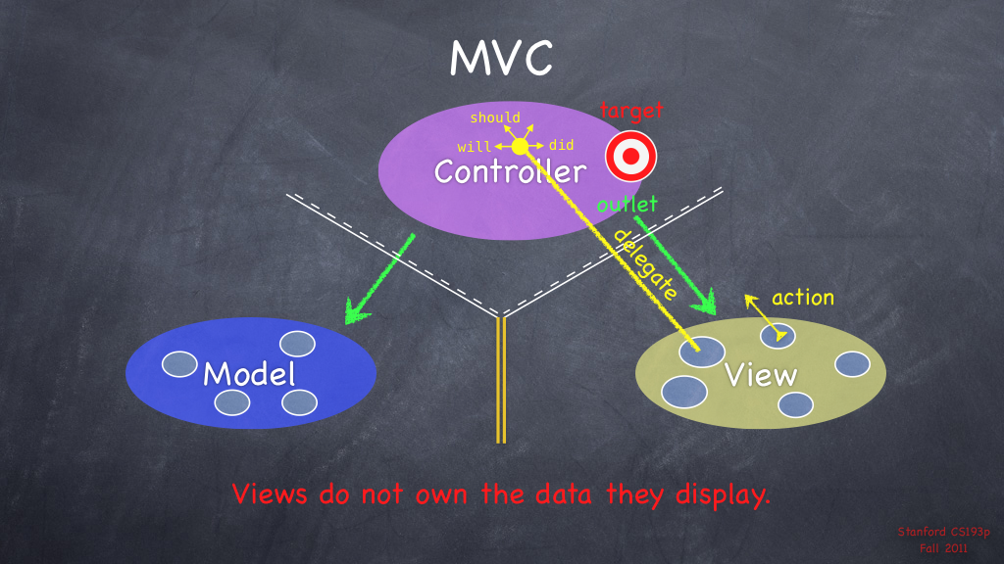

Slide 20
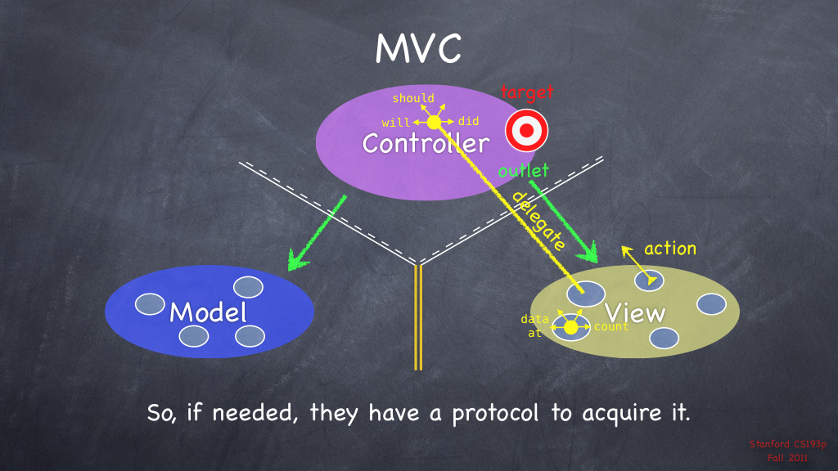

Slide 21
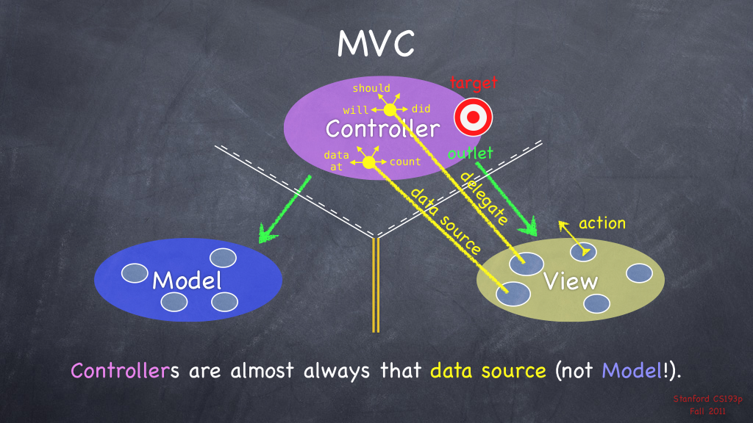

Slide 22
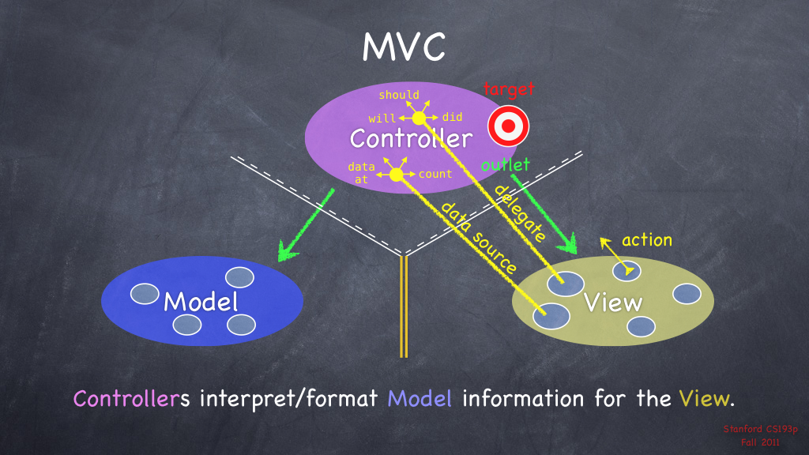

Slide 23
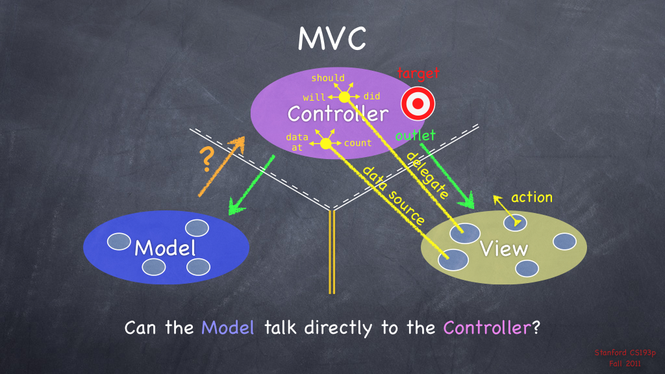

Slide 24
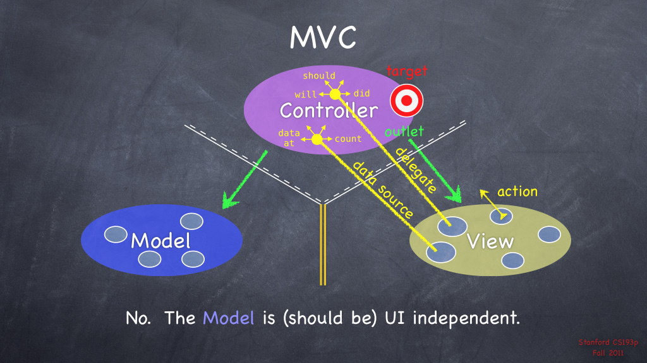

Slide 25
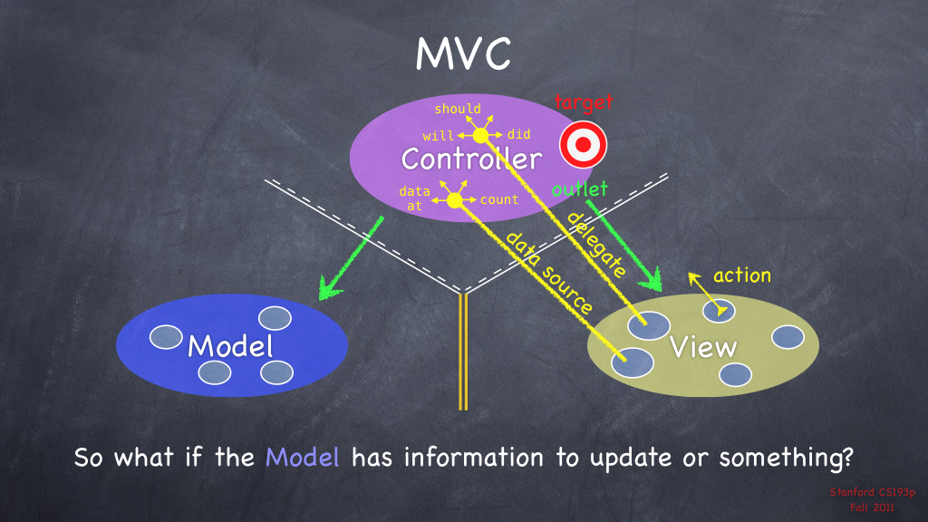

Slide 26
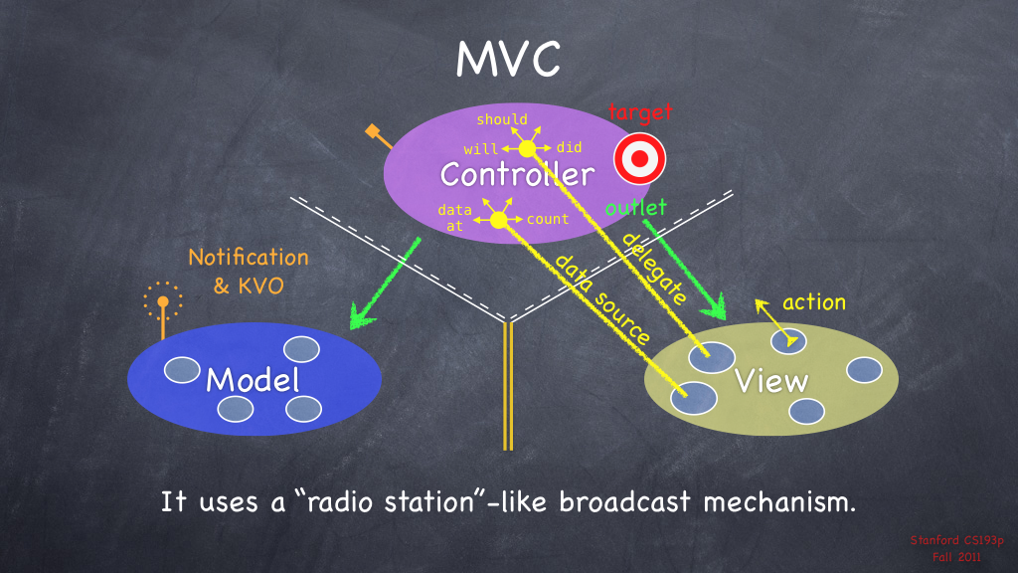

Slide 27
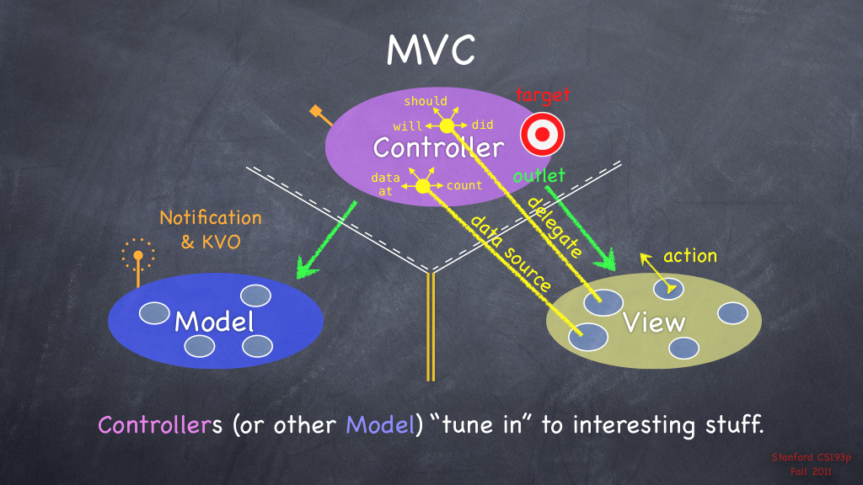

Slide 28
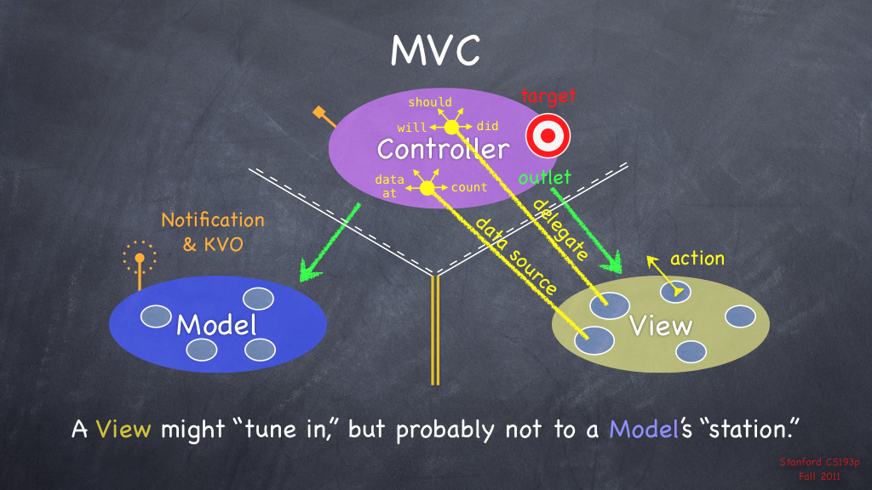

Slide 29


Slide 30
Converter App – Another MVC Example

